Slide 1
PENERAPAN SOFTWARE PRODUCT LINE DALAM PENGEMBANGAN ROLE-PLAYING GAME
Fariz Abirafdi Benarto

Slide 2
Latar Belakang

Slide 3
Latar Belakang
Game Development

Slide 4
Latar Belakang
Game Development
How to Improve?

Slide 5
Latar Belakang
Game Development
How to Improve?
Software Development Methodologies

Slide 6
Latar Belakang
Game Development
How to Improve?
Software Development Methodologies
Software Product Line

Slide 7
Rumusan Masalah

Slide 8
Rumusan Masalah
“Bagaimana SPL dapat diimplementasikan dalam pengembangan game?”

Slide 9
Rumusan Masalah
“Apakah bentuk implementasi tersebut lebih baik dibandingkan dengan paradigma pengembangan sebelum menerapkan SPL?”

Slide 10
Tinjauan Literatur

Slide 11
Software Product Line

Slide 12
Software Product Line
“A software product line (SPL) is a set of software-intensive systems that share a common, managed set of features satisfying the specific needs of a particular market segment or mission and that are developed from a common set of core assets in a prescribed way”
Clement & Northrop (2001)

Slide 13
Software Product Line
Commonality and Variability

Slide 14
Software Product Line
Commonality and Variability
“Common requirements form the basis of every software product line application”
Pohl et al (2005)

Slide 15
Software Product Line
Commonality and Variability
“Common requirements form the basis of every software product line application”
“The aim of the application engineering process is to derive specific applications by exploiting the variability of the software product line”
Pohl et al (2005)

Slide 16
Software Product Line
Paradigm

Slide 17
Software Product Line
Paradigm
“Object-oriented techniques support variability management through a variety of techniques including domain and feature analysis, inheritance and polymorphism”
McGregor (2001)

Slide 18
Software Product Line
Advantages

Slide 19
Software Product Line
Advantages
“Software reuse and family-based production strategies, including SPLs, make software engineering more effective and productive”
Furtado et al (2011)

Slide 20
Software Product Line
Advantages
“Software reuse and family-based production strategies, including SPLs, make software engineering more effective and productive”
“Such strategies let software designers and engineers analyze and implement systems collectively rather than separately”
Furtado et al (2011)

Slide 21
Software Product Line
Advantages
“Software reuse and family-based production strategies, including SPLs, make software engineering more effective and productive”
“Such strategies let software designers and engineers analyze and implement systems collectively rather than separately”
“Automating more of the software life cycle through reusable domain assets”
Furtado et al (2011)

Slide 22
Software Product Line
Disadvantages
Furtado et al (2011)

Slide 23
Software Product Line
Disadvantages
“Several factors have hindered digital game developers from implementing SPL”
Furtado et al (2011)

Slide 24
Software Product Line
Disadvantages
“Several factors have hindered digital game developers from implementing SPL”
Engineering is the hardest part of game development
Furtado et al (2011)

Slide 25
Software Product Line
Disadvantages
“Several factors have hindered digital game developers from implementing SPL”
Engineering is the hardest part of game development
Characterized by ad hoc low-level development
Furtado et al (2011)

Slide 26
Software Product Line
Disadvantages
“Several factors have hindered digital game developers from implementing SPL”
Engineering is the hardest part of game development
Characterized by ad hoc low-level development
Developers struggle with integrating components and managing their architectural complexity
Furtado et al (2011)

Slide 27
Software Product Line
Disadvantages
“Several factors have hindered digital game developers from implementing SPL”
Engineering is the hardest part of game development
Characterized by ad hoc low-level development
Developers struggle with integrating components and managing their architectural complexity
Traditional requirements engineering isn’t applicable
Furtado et al (2011)

Slide 28
Software Product Line
Disadvantages
“Several factors have hindered digital game developers from implementing SPL”
Engineering is the hardest part of game development
Characterized by ad hoc low-level development
Developers struggle with integrating components and managing their architectural complexity
Traditional requirements engineering isn’t applicable
Furtado et al (2011)

Slide 29
Domain-Specific Language

Slide 30
Domain-Specific Language
“A systematic process for exploiting software product lines for game development offers both domain-specific languages and generators streamlined for game subdomains”
Furtado et al (2011)

Slide 31
Refactoring

Slide 32
Refactoring
Object-oriented

Slide 33
Refactoring
Object-oriented
Inheritance
Polymorphism
Interface
Fowler (2001)

Slide 34
Studi Kasus

Slide 35
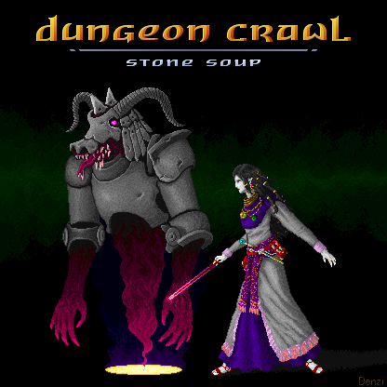

Slide 36
Dungeon Crawl Stone Soup

Slide 37
Dungeon Crawl Stone Soup
Genre: Roguelike

Slide 38
Dungeon Crawl Stone Soup
Genre: Roguelike
Grafis: ASCII

Slide 39
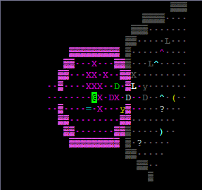
Dungeon Crawl Stone Soup
Genre: Roguelike
Grafis: ASCII

Slide 40
Dungeon Crawl Stone Soup
Genre: Roguelike
Grafis: ASCII
Tile-Based

Slide 41
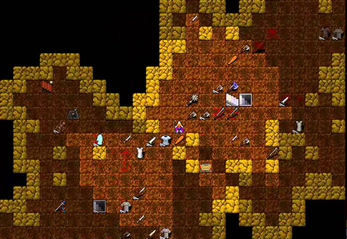
Dungeon Crawl Stone Soup
Genre: Roguelike
Grafis: ASCII
Tile-Based

Slide 42
Dungeon Crawl Stone Soup
Genre: Roguelike
Grafis: ASCII
Tile-Based
Availability: Open-Source

Slide 43
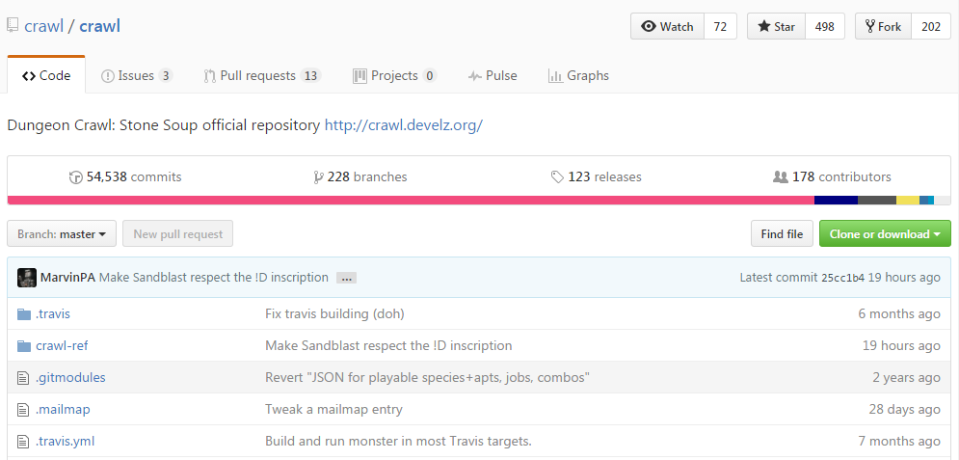
Dungeon Crawl Stone Soup
Genre: Roguelike
Grafis: ASCII
Tile-Based
Availability: Open-Source

Slide 44

Dream Sheep

Slide 45
Dream Sheep
New Monster Addition

Slide 46
Dream Sheep
New Monster Addition
9 source code files

Slide 47
Dream Sheep
New Monster Addition
9 source code files
20+ data files

Slide 48
Dream Sheep
New Monster Addition
9 source code files
20+ data files
Simpler addition?

Slide 49
Rancangan Eksperimen

Slide 50
Commonalities & Variabilities
Commonalities

Slide 51
Commonalities & Variabilities
Commonalities
Function User

Slide 52
Commonalities & Variabilities
Commonalities
Function User
Monster Component

Slide 53
Commonalities & Variabilities
Commonalities
Function User
Monster Component
Variabilities

Slide 54
Commonalities & Variabilities
Commonalities
Function User
Monster Component
Variabilities
Identity

Slide 55
Commonalities & Variabilities
Commonalities
Function User
Monster Component
Variabilities
Identity
Power Configuration

Slide 56
Commonalities & Variabilities
Commonalities
Function User
Monster Component
Variabilities
Identity
Power Configuration
Movement and Attacking Pattern/Behavior

Slide 57
Commonalities & Variabilities
Commonalities
Function User
Monster Component
Variabilities
Identity
Power Configuration
Movement and Attacking Pattern/Behavior
Spell

Slide 58
Commonalities & Variabilities
Commonalities
Function User
Monster Component
Variabilities
Identity
Power Configuration
Movement and Attacking Pattern/Behavior
Spell
Ability

Slide 59
Commonalities & Variabilities
Commonalities
Function User
Monster Component
Variabilities
Identity
Power Configuration
Movement and Attacking Pattern/Behavior
Spell
Ability

Slide 60
CRC Cards

Slide 61
CRC Cards
Class-Responsibility-Collaboration

Slide 62
CRC Cards
Class-Responsibility-Collaboration
Class

Slide 63
CRC Cards
Class-Responsibility-Collaboration
Class: Monsters

Slide 64
CRC Cards
Class-Responsibility-Collaboration
Class: Monsters
Responsibilities:

Slide 65
CRC Cards
Class-Responsibility-Collaboration
Class: Monsters
Responsibilities:
Texts

Slide 66
CRC Cards
Class-Responsibility-Collaboration
Class: Monsters
Responsibilities:
Texts
Behavior

Slide 67
CRC Cards
Class-Responsibility-Collaboration
Class: Monsters
Responsibilities:
Texts
Behavior
Spell

Slide 68
CRC Cards
Class-Responsibility-Collaboration
Class: Monsters
Responsibilities:
Texts
Behavior
Spell
Collaboration

Slide 69
CRC Cards
Class-Responsibility-Collaboration
Class: Monsters
Responsibilities:
Texts
Behavior
Spell
Collaboration

Slide 70
Code Differences

Slide 71
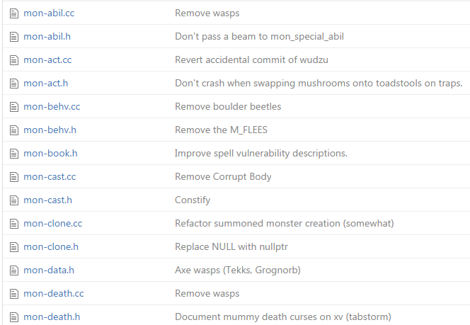
Code Differences
File Categorization

Slide 72
Code Differences
Original Structure

Slide 73
Code Differences
Original Structure
Spell
{
Spell monster 1
Spell monster 2
Spell monster 3
}
Behavior
{
Pola gerakan monster 1
Pola gerakan monster 2
Pola gerakan monster 2
}
Data
{
Data monster 1
Data monster 2
Data monster 3
}

Slide 74
Code Differences
Original Structure
Spell
{
Spell monster 1
Spell monster 2
Spell monster 3
}
Behavior
{
Pola gerakan monster 1
Pola gerakan monster 2
Pola gerakan monster 2
}
Data
{
Data monster 1
Data monster 2
Data monster 3
}
Proposed Structure
Monster 1
{
Spell monster 1
Pola gerakan monster 1
Data monster 1
}
Monster 2
{
Spell monster 2
Pola gerakan monster 2
Data monster 2
}
Monster 3
{
Spell monster 3
Pola gerakan monster 3
Data monster 3
}

Slide 75
Code Differences
Original Structure
Spell
{
Spell monster 1
Spell monster 2
Spell monster 3
}
Behavior
{
Pola gerakan monster 1
Pola gerakan monster 2
Pola gerakan monster 2
}
Data
{
Data monster 1
Data monster 2
Data monster 3
}
Proposed Structure
Monster 1
{
Spell monster 1
Pola gerakan monster 1
Data monster 1
}
Monster 2
{
Spell monster 2
Pola gerakan monster 2
Data monster 2
}
Monster 3
{
Spell monster 3
Pola gerakan monster 3
Data monster 3
}

Slide 76
Code Differences
New Monster Addition

Slide 77
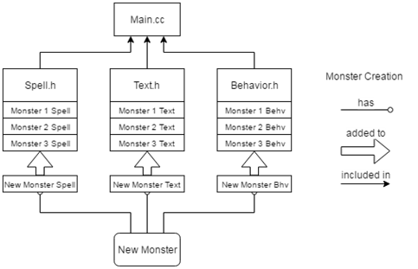
Code Differences
New Monster Addition (Old Code)

Slide 78
Code Differences
New Monster Addition (New Code)

Slide 79
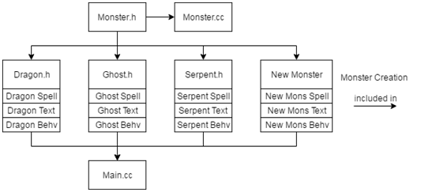
Code Differences
New Monster Addition (New Code)

Slide 80
Integration to Game Source Code

Slide 81
Integration to Game Source Code
Object-oriented Refactoring

Slide 82
Integration to Game Source Code
Object-oriented Refactoring
Score Calculation System

Slide 83
Integration to Game Source Code
Object-oriented Refactoring
Score Calculation System
Experience Management System

Slide 84
Integration to Game Source Code
Object-oriented Refactoring
Score Calculation System
Experience Management System
Dream Sheep

Slide 85
Integration to Game Source Code
Object-oriented Refactoring
Score Calculation System
Experience Management System
Dream Sheep
Dream Dust Spell

Slide 86
Eksperimen

Slide 87
Score Calculation System

Slide 88
Score Calculation System
hiscores.h

Slide 89
Score Calculation System
hiscores.h
hiscores.cc

Slide 90
Score Calculation System
hiscores.h
hiscores.cc
_award_modified_experience()

Slide 91
Score Calculation System
hiscores.h
hiscores.cc
_award_modified_experience()
scorefile_entry::init()

Slide 92
Experience Management System

Slide 93
Experience Management System
mon-death.h

Slide 94
Experience Management System
mon-death.h
mon-death.cc

Slide 95
Experience Management System
mon-death.h
mon-death.cc
_calc_monster_experience()
_give_monster_experience()
_beogh_spread_experience()
_calc_player_experience()
_give_player_experience()
_give_experience()

Slide 96
Dream Sheep

Slide 97
Dream Sheep
mon-cast.cc

Slide 98
Dream Sheep
mon-cast.cc
MIN_DREAM_SPELL_SUCCESS

Slide 99
Dream Sheep
mon-cast.cc
MIN_DREAM_SPELL_SUCCESS
_sheep_message()

Slide 100
Dream Sheep
mon-cast.cc
MIN_DREAM_SPELL_SUCCESS
_sheep_message()
_dream_sheep_sleep()

Slide 101
Analisis

Slide 102
Analisis
Low coupling

Slide 103
Analisis
Low coupling
High cohesion

Slide 104
Analisis
Low coupling
High cohesion
Development Effort

Slide 105
Analisis
Low coupling
High cohesion
Development Effort
Easier monster addition

Slide 106
Analisis
Low coupling
High cohesion
Development Effort
Easier monster addition
Even more easier monster derivation

Slide 107
Thank You

